Slide 1
LSTM Neural Network Candlestick Forecasting for Short-term Trading Opportunities
SPRINGBOARD DATA SCIENCE, CAPSTONE THREE, 2021
Trent Leslie

Slide 2
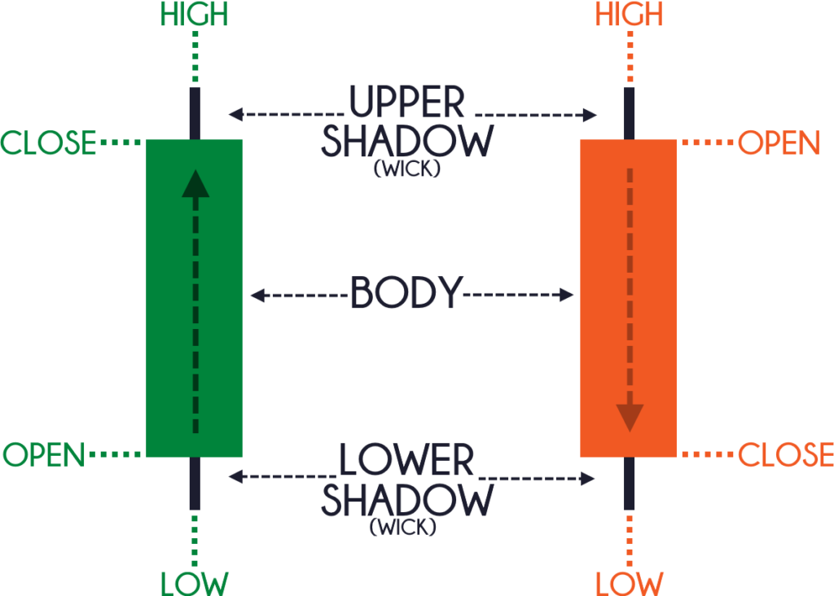
Introduction
Use of neural networks to identify patterns in OHLC data
A popular approach in technical analysis is the use of candlestick patterns
Incorporating information other than historical price itself, such as volume, moving averages, and RSI
What are the expected open, high, low, and close (OHLC) prices for a given index, stock, ETF, forex, or futures contract tomorrow?

Slide 3

The Data
Alpha Vantage API
https://www.alphavantage.co/documentation/
Daily Price Data (per ticker)
01/11/2000 – 12/07/2021
5,513 rows
11 columns (11 float)
Started with 25 tickers, removed 4 for a total of 21 tickers
Resulted in ~100,000 rows of data for training and testing

Slide 4
The Data
Daily Price Data (per ticker)
Open, high, low, close (OHLC) prices
Adjusted close
Volume
Dividend Amount
Split Coefficient
21-day exponential moving average (EMA)
50-day simple moving average (SMA)
14-day relative strength index (RSI)

Slide 5
The TICKERS
1) SPY: SPDR S&P 500 ETF Trust
2) QQQ: Invesco QQQ Trust (Nasdaq)
3) XLF: Financial Select Sector SPDR Fund
4) EEM: iShares MSCI Emerging Markets ETF
5) XLE: Energy Select Sector SPDR Fund
6) SLV: iShares Silver Trust
7) FXI: iShares China Large-Cap ETF
8) GDX: VanEck Gold Miners ETF
9) EFA: iShares Core MSCI EAFE ETF
10) TLT: iShares 20+ Year Treasury Bond ETF
11) LQD: iShares iBoxx $ Investment Grade Corporate Bond ETF
12) XLU: Utilities Select Sector SPDR Fund
13) XLV: Health Care Select Sector SPDR Fund
14) XLI: Industrial Select Sector SPDR Fund
15) IEMG: iShares Core MSCI Emerging Markets ETF
16) VWO: Vanguard FTSE Emerging Markets ETF
17) XLK: Technology Select Sector SPDR Fund
18) IEF: iShares 7-10 Year Treasury Bond ETF
19) XLB: Materials Select Sector SPDR Fund
20) JETS: U.S. Global Jets ETF (airlines)
21) BND: Vanguard Total Bond Market ETF

Slide 6
Eda & pREPROCESSING
Window Sizing
Each window size has its own training data set
10, 20, 30, 40, 80, 160, 320, and 640 periods
For each window size, the 21 ticker symbol data sets that were independently standardized
After standardization, each window in the sliding view over time was then flattened to one row
Each data set contains [window size * 8)] feature columns and four target columns (open, high, low, close)
The ticker data sets for each window size were then concatenated

Slide 7
Eda & pREPROCESSING
Window Sizing
Each window size has its own training data set
10, 20, 30, 40, 80, 160, 320, and 640 periods
For each window size, the 21 ticker symbol data sets that were independently standardized
After standardization, each window in the sliding view over time was then flattened to one row
Each data set contains [window size * 8)] feature columns and four target columns (open, high, low, close)
The ticker data sets for each window size were then concatenated

Slide 8
Eda & pREPROCESSING
Column Name | Process
open | absolute dollar value -> percent change -> sliding window generation -> rolling z-score (standardization based on window size) -> flatten -> concatenate
high | absolute dollar value -> percent change -> sliding window generation -> rolling z-score (standardization based on window size) -> flatten -> concatenate
low | absolute dollar value -> percent change -> sliding window generation -> rolling z-score (standardization based on window size) -> flatten -> concatenate
close | absolute dollar value -> percent change -> sliding window generation -> rolling z-score (standardization based on window size) -> flatten -> concatenate
volume | absolute value -> percent change -> sliding window generation -> rolling z-score (standardization based on window size) -> flatten -> concatenate
ema (exponential moving average) | percent of close -> sliding window generation -> rolling z-score (standardization based on window size) -> flatten -> concatenate
sma (simple moving average) | percent of close -> sliding window generation -> rolling z-score (standardization based on window size) -> flatten -> concatenate
rsi (relative strength index) | sliding window generation -> rolling z-score (standardization based on window size) -> flatten -> concatenate

Slide 9

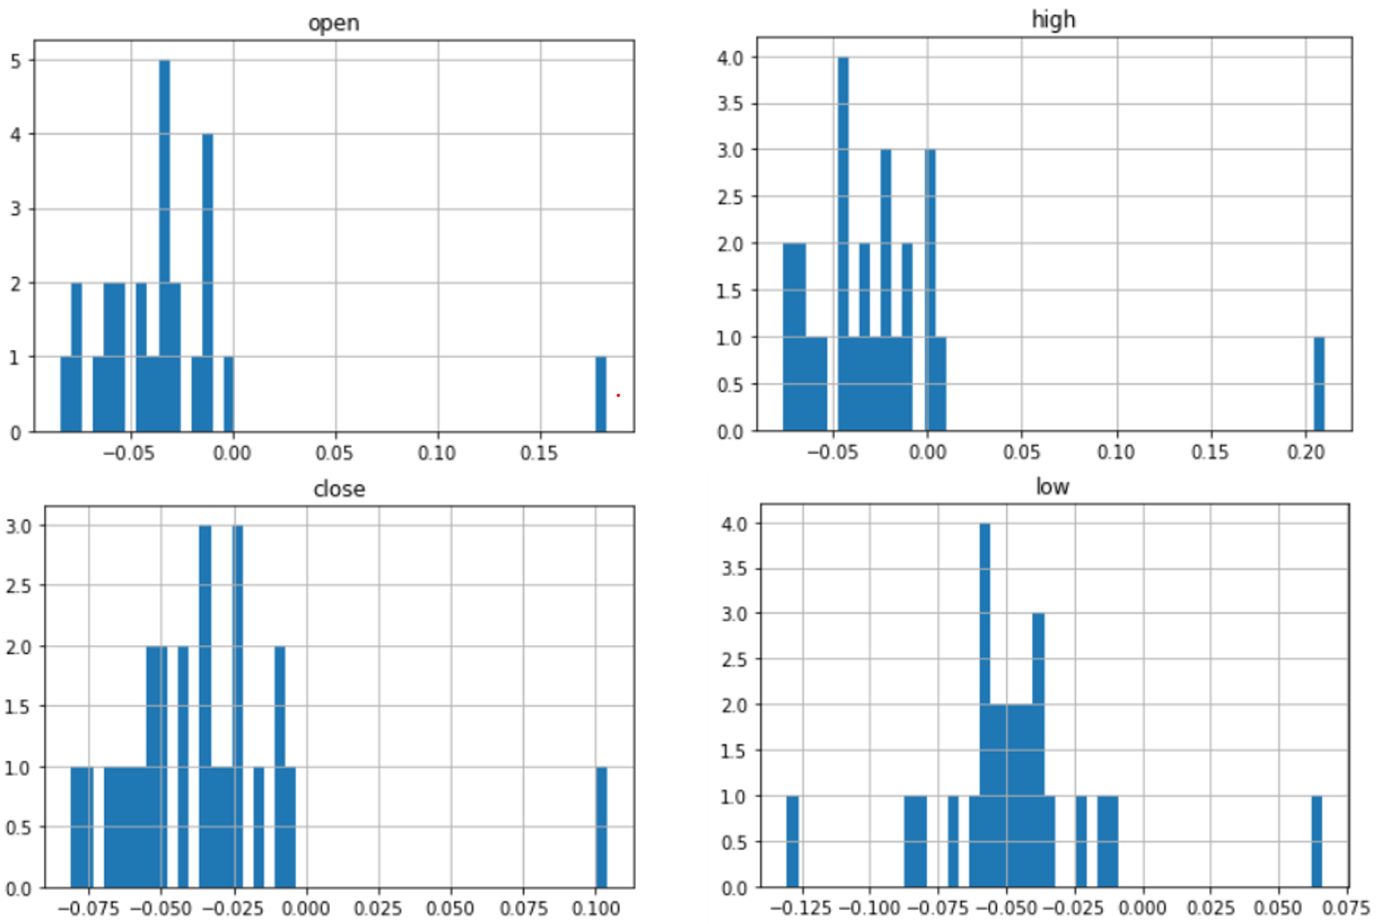
Eda & pREPROCESSING
Removal of 4 of the original 25 ticker symbols
Distributions of mean z-scores for the respective feature in the 10-period window
Infinite percent changes in volume data sets

Slide 10
Eda & pREPROCESSING
ticker | stat | open | high | low | close | volume
EWZ | mean | -0.035341987 | -0.022547611 | -0.041337936 | -0.035761034 | inf
EWZ | std | 1.318922066 | 1.296249446 | 1.311434566 | 1.269684114
HYG | mean | -0.075503843 | -0.069374342 | -0.130310442 | -0.081008299 | 0.108681252
HYG | std | 1.377978434 | 1.42122522 | 1.4553079 | 1.379505735 | 1.564697531
IEF | mean | -0.01353213 | 0.003001705 | -0.021122435 | -0.009079921 | inf
IEF | std | 1.285227133 | 1.297855472 | 1.288484378 | 1.254383555
JNK | mean | 0.182613617 | 0.209941282 | 0.065949746 | 0.103816158 | 0.126315129
JNK | std | 16.25910553 | 18.23264211 | 11.72257763 | 11.77547138 | 1.638226284

Slide 11
Training
Python 3.6.6
Tensorflow 2.1.0
Tensorboard 2.1.1
Epoch loss and epoch mean absolute error used for model performance
Evaluated only on target close values (not target open, high, or low values)
Shah, Dev, Wesley Campbell, and Farhana H. Zulkernine. "A comparative study of LSTM and DNN for stock market forecasting." 2018 IEEE International Conference on Big Data (Big Data). IEEE, 2018.

Slide 12
Training
Experiment with epoch count, activation functions, layers, and unit count.
Epoch count did little past 25 epochs
Linear, elu, selu, and tanh activation functions performed the best
Layers offered little improvement with more than three layers
Unit counts moving from 40 to 1000 offered a great improvement
Increasing window size also had a drastic and positive impact up to 320 period

Slide 13
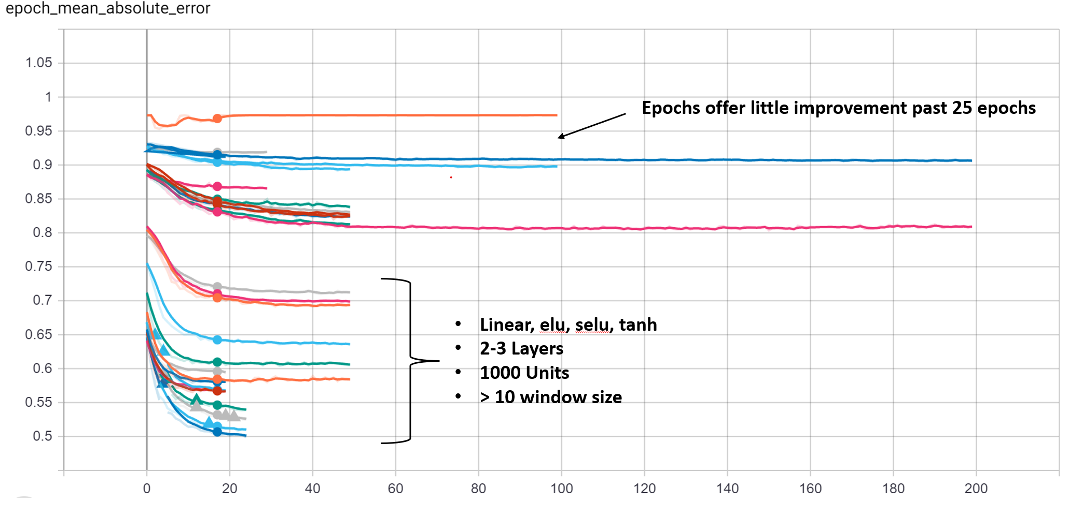
Training
Mean Absolute Error over Epoch Training

Slide 14
Model selection
Eight models selected
Two window sizes
20-period
320-peried
Four activation functions for each window size
Linear
Elu
Selu
Tanh

Slide 15
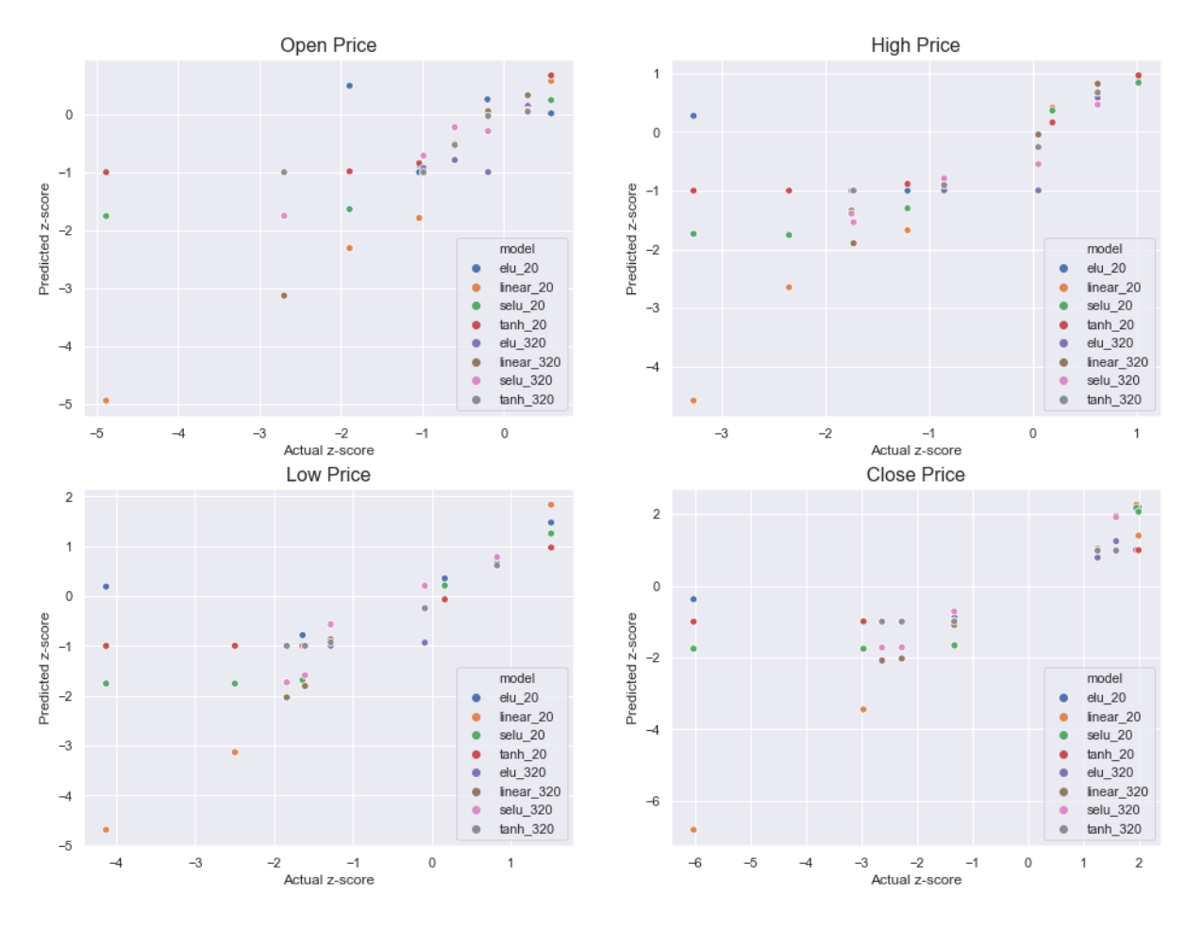
Evaluation
Predicted z-score vs. actual z-score for previous five trading days (11/26/2021 – 12/2/2021)
linear_20 model performance on the low z-scores is impressive

Slide 16
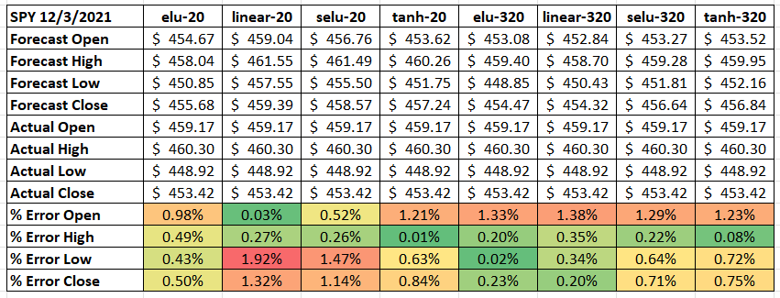
Evaluation
Percent Error on Absolute Values for SPY on 12/3/2021

Slide 17
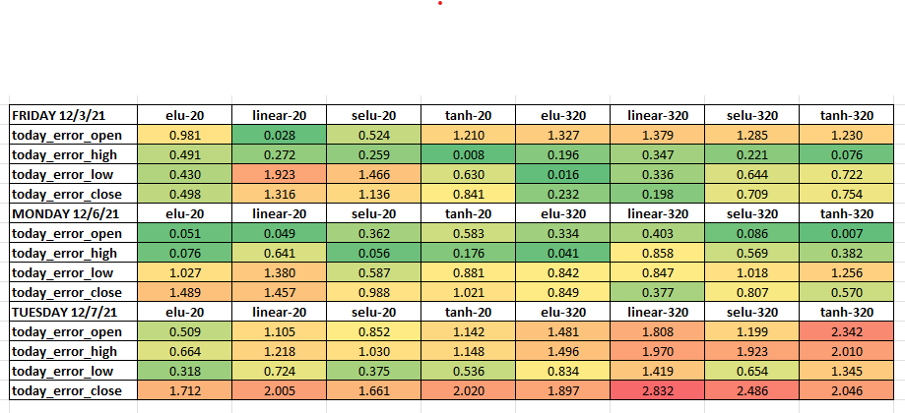
Evaluation
Percent Error on Absolute Values for SPY on 12/3/2021 – 12/7/2021
12/7/2021 was a 2% gain day for SPY
The 20-period models fared poorly, but the 320-period models didn’t see it coming at all

Slide 18
Conclusions
Forecasting next-day OHLC data in a useful way is difficult
However, some combinations of activation functions and window sizes seem to be more promising than others
The use of z-scores makes the models harder to use, but much more flexible
The linear_20 model will be interesting for the next big selloff day – will it see it coming like it did Black Friday?
These models will need to be used in conjunction with other information for use in any actual decision-making

Slide 19
Data Limitations & Constraints
Data Limitations
Limited to 20 years of data
Because it’s based on z-scores of multiple tickers, it can’t incorporate data specific to the ticker that could help provide a better forecast
Constraints
Training data is limited to ETF ticker symbols
Training data is limited to daily price data

Slide 20
Recommendations
To establish a baseline for future models, maintain records on performance moving forward with unseen data
Consider an “ensemble” method for neural networks
Train dozens of models with identical (or nearly identical) parameters to the same target
Then use the forecasts of these dozens of models to not only establish a forecast, but a confidence interval on the forecast
Consider a tight confidence interval day an opportunity
Consider training models to individual targets instead of all four at once

Slide 21
Future Work
Expanded use of the current models
More tickers
Different timeframes, such as weekly data
Different asset classes, such as forex and cryptocurrency
Development of new models:
Using the same training data to forecast the next week’s OHLC candle
Incorporate one-hot encoding data, such as treasuries, corporate bonds, and precious metals via the ETF price data already in the dataset
Incorporating more and/or different technical indicators to the model.
Move more intensive training to the cloud
Explore adding more units to each layer

